Slide 1


CRC students:
The next generation of innovative, collaborative problem solvers?

Slide 2
CRC Programme Objectives
Equip students with the skills and attributes to be productive in the Centre’s field
Promote a cooperative approach to research and education in the Centre’s field
Ensure that the Parties with their differing disciplines and backgrounds add value to each other

Slide 3
“CRC education programs act as innovation hubs”
  We have the flexibility and interest to try novel approaches to complex problems for industry
  We can innovate, pilot and transition successful education programs
  Our students are key part of each CRCs legacy

Slide 4
CRC for Mental Health
Seeks to discover and validate biomarkers for mental illnesses
19 Participant organisations
  4 Universities
  4 Hospitals / health care / aged care industry
  4 Small-to-medium enterprises
  Pharmaceutical partners

Slide 5
Challenges in our area
Majority of PhD (>80%) will not continue in academic careers
Office of Chief Scientist, employers report PhD graduates lack practical experience
Laboratory based PhD students can be isolated – from each other and the communities their work can benefit

Slide 6

Career Dreams vs. Career Realities
80%
85%
Percentage
60%
40%
20%
19%
University research
University teaching
Non-university research
Business
Government
Not for profit
Other

Slide 7
What we want for our students
A connected, collaborative cohort
Empathy with people affected by mental illnesses
Confidence, willingness, skills and networks to engage in multidisciplinary research and translational activities
Demonstrated experience and success working cooperatively with researchers and non-researchers

Slide 8
Developing a cohesive cohort… quickly

Slide 9
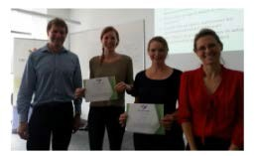
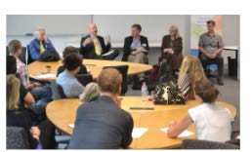
Annual PhD workshop
1.5 days in duration, gather all students in one location
Themed days developed in collaboration with input from our Participants and students
Incorporates development and pitch of collaborative project

Slide 10
Themes
What do you need to be a “successful scientist”?
Research translation
Communicating as a scientist
What is a successful career and how do you get one
How to turn research discoveries into new products and methods of practice … without hurting anyone, getting sued or going bankrupt
How to survive and thrive in your PhD and beyond

Slide 11
Problems …
Students tended to drift post-workshop
Six months until next formal contact
Limited collaboration seen in group between formal events

Slide 12
Videoconferences

Slide 13
Monthly professional development videoconferences
Alternates between skill development and awareness of potential career paths and development that students can be doing now to trial or build experience in that area

Slide 14
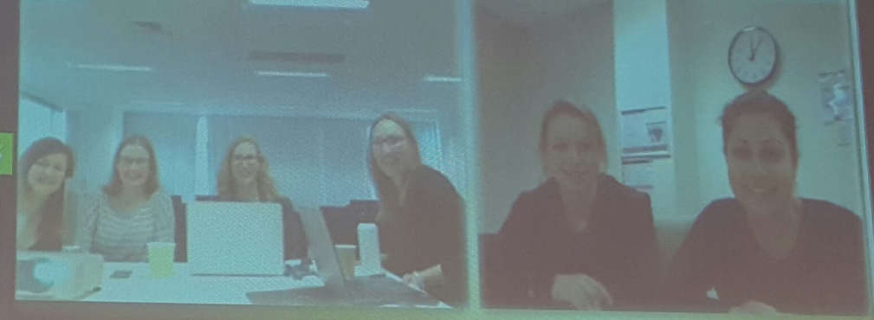
Monthly videoconferences
Speakers have included: management consultant, radio host, science communicator, university lecturer, accountant, research staff member (industry)
Introduction of recording

Slide 15
Student involvement in videoconferences
As audience
Students as guests to increase value of external training/events they’ve attended
Asking the questions
  During the sessions (interactive)
  Preparing beforehand to build a relationship with guest (networks!)

Slide 16
Collaborative Writing Program
Notes:
I worked with Mel and the CRC to develop
Opportunity to – active problem solve, develop a program to fill a need, take on a leadership role and coordinate a project

Slide 17
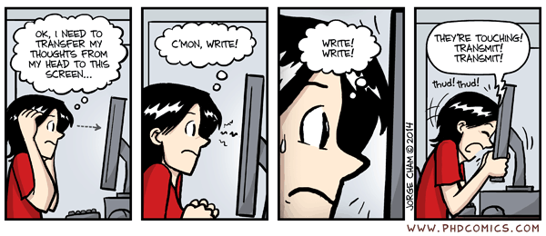
Notes:
One of the main outputs for a PhD student is writing – be it there thesis, an academic manuscript, grant application, report etc. and it can be a real change to stay motivated and to get words on the page
This was one of the initial inspirations for the collaborative writing program – to provide a space and community to support the CRC students to write productively

Slide 18
Aims
Provide dedicated writing time/space
Enhance workforce capability
Reduce mental health risk

Slide 19
Workforce Capability
  Interpersonal and Leadership Skills
  Peer Mentorship and Consultation
  Active Problem Solving
  Networking and Collaboration
  Project Management and Organisation
  Self-management to Work Effectively

Slide 20
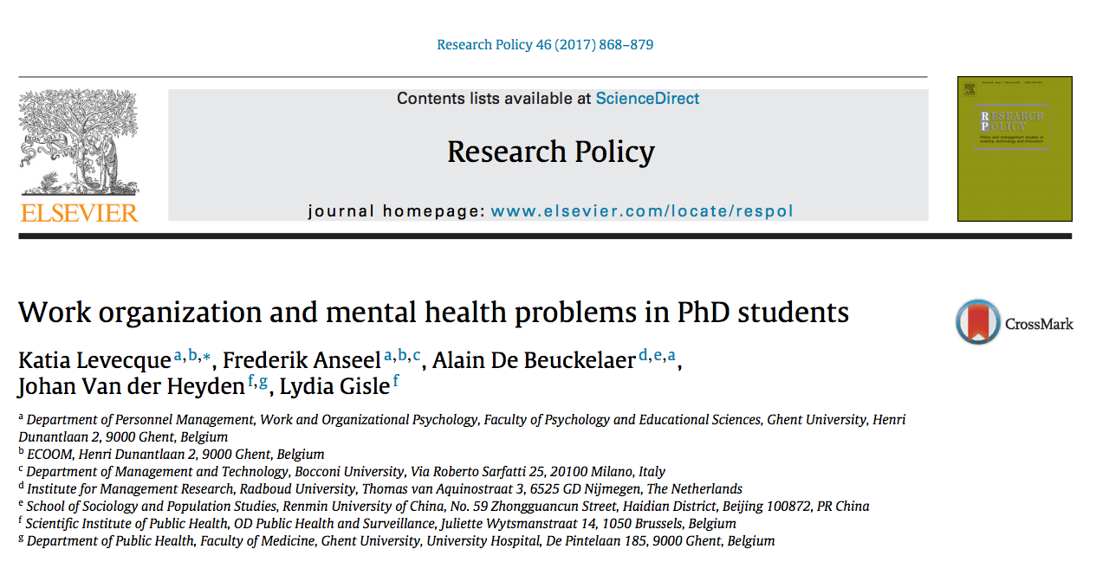
PhD student mental health:
50% experience psychological distress
30% are at risk of depression and anxiety

Slide 21
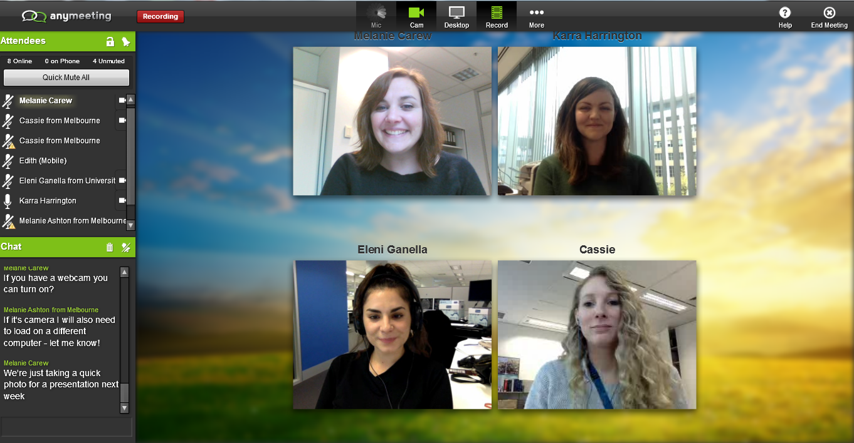
Notes:
Monthly group writing sessions (2 hours)
Adapted from the “Shut up & Write Program”
Student-led and designed
Consistent time and format each month
Semi-closed group (consistency of participants)
Videoconferencing Allows participation of students across multiple sites including interstate
Low Cost Videoconference Platform
Any Meeting
Zoom

Slide 22

Session Format
0 hr
0.5 hr
1 hr
1.5 hr
2 hr
Writing Block – 25 mins
Break - 5 mins

Slide 23
CRCMH Collaborative Writing Session
0 hr
0.5 hr
1 hr
1.5 hr
2 hr
Writing Block – 20 mins
Break - 5 mins
Facilitated Discussion - 10 mins
Discussion Topic - 10 mins
Notes:
Session coordinators introduce topics
Broad question prompts:
What’s something good that’s happened in the past month?
What’s something that you’re struggling with?
What interests you at the moment?
What moves are you making now to work towards your long term goals?
Group members lead discussion of issues/topics raised by students during the session
Dealing with rejections by journals
Balancing career goals and family needs
Staying motivated
How to talk about you PhD project with family/partner/friends
Themes can be identified from these discussions to guide future learning opportunities

Slide 24
“Attending the writing group ensures I set aside good quality dedicated writing time, and also learn from my peers about what they’re going through. It helps to be able to normalise the lows and highs of a PhD among like-minded people. The focus and structure of the time actually writing means I always come out having made progress on my thesis, even during times I have been struggling with motivation.”
- Melanie Ashton, CRC for Mental Health PhD Candidate

Slide 25
“ The usual demands of research sometimes make it difficult to allocate enough uninterrupted time for writing, but the group has been instrumental in providing an opportunity to schedule this in on a regular basis. Also as a part of this programme, the opportunity to connect with other research students who are working in similar fields has been invaluable, to share experiences, and support each other on our journeys.”
- Michelle Tegg, CRC for Mental Health PhD Candidate
Notes:
Feel a part of a community/sense of belonging
Increased productivity from accountability to the group and dedicated writing time
Problem solving to “get unstuck” or deal with issues
Increased confidence and motivation
Less isolated through shared writing experience

Slide 26
Activity

Slide 27
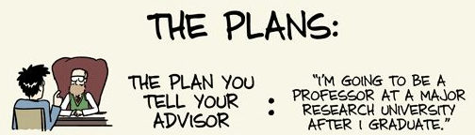

Notes:
As a PhD Candidate, I’ve often wondered, what will the next step be in my career? Will I get a Post Doc position? Should I stay in academia?

Slide 28
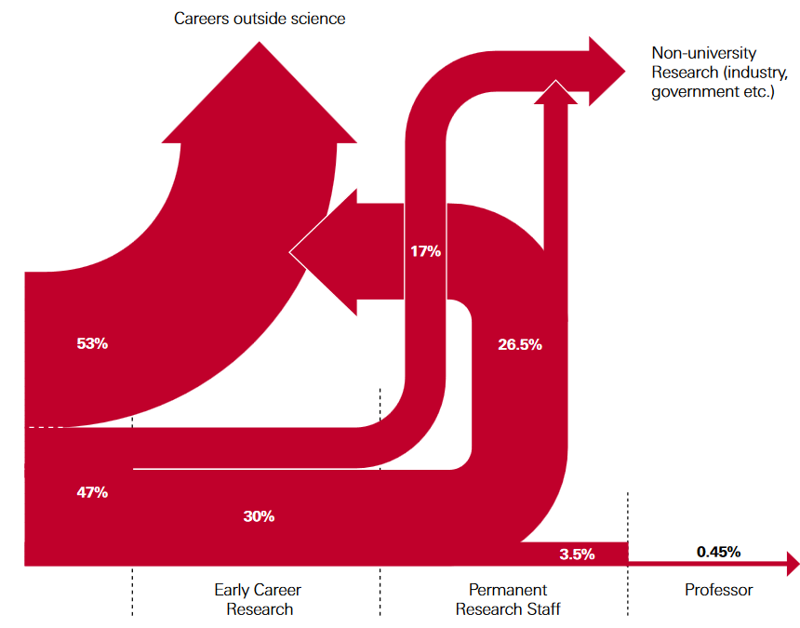
Career Realities
Only 3% of PhD students will go on to have a career in research
PhD Graduates
Notes:
As a student, I’m told repeatedly that most PhD graduates will not continue in academic careers. This infographic from 2010 shows that only about 3% of PhD students from the Sciences will stay involved in academic research. So, what will I do next? How do I build a career?
Perhaps I should turn to industry, government or business?
Many PhD graduates start to explore their options too late and it comes as a surprise when the skills developed during a PhD, such as critical thinking, complex problem solving, and even time-management skills; are sometimes not enough to ensure a job in the business industry.

Slide 29
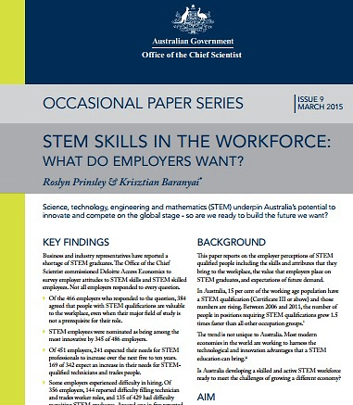
What do employers want?
Where respondents did not employ PhDs, it was because:
  “They lacked practical experience” (50% of respondents)
And the quality of applications received from PhD graduates, showed a
  Lack of business understanding
  (36% of respondents)
  Lack of general workplace experience (35% of respondents)
Notes:
The evidence suggests that employers want to hire PhD graduates with practical experience, a business understanding, and general workplace experience.
So, I started thinking, how am I going to be able to acquire all these skills and get this experience, while doing all the things I need to do to get a PhD?

Slide 30
Short consulting projects – Publico program
Entirely voluntary
6 – 8 week project in January to February each year
Benefits to the ‘client’ (business or not for profit)
  Students undertaking a real business project that they need solved
  Businesses and Not-for-profits gain exposure and some understanding of the benefit of scientific training and hiring science graduates
Notes:
This is where the CRC for Mental Health education program comes into play. Mel offered all the CRC students the opportunity to develop some of the much-needed workforce skills by taking part in a short consulting project (termed the Publico program).
Participation in the consulting project was entirely voluntary, short-term, 6-8 weeks, and during the relatively quieter months of the year- January and February.
We were told it would involve working as a consultant to a small business or not-for-profit organisation to solve a project or issue they might have, therefore allowing us PhD Candidates to apply our own knowledge and skills gained during our PhD to make an impact on/to a business.

Slide 31

The Reach Foundation
Deliver school and community programs to improve mental health and wellbeing
Notes:
The first short consulting project I became involved in was with The Reach Foundation. The Reach Foundation is a youth-lead not-for-profit organisation based in Melbourne. The Reach Foundation delivers school and community programs to improve mental health and wellbeing among the youth in Melbourne and Victoria.
Having previously been involved in a few Reach programs back in high-school, it was of particular interest to me to see where the organisation was at and how the programs had progressed along.

Slide 32
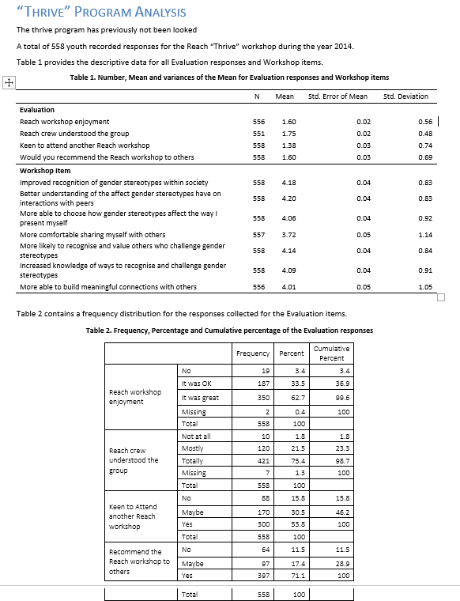
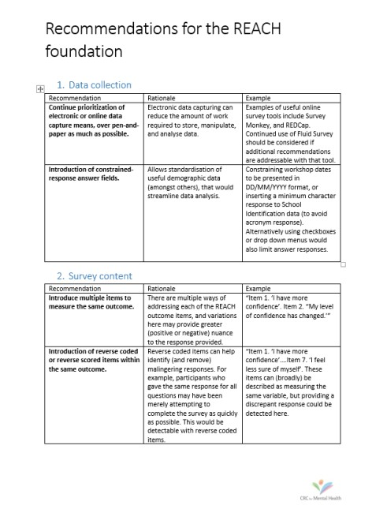
The Reach Foundation
In 6 weeks, we:
Assessed the needs of the organisation
Assessed and cleaned survey data
Undertook a complete analysis of the data and produced a report on the findings
Provided recommendations for future program evaluations
  better survey question wording,
  use of available (free) software to collate data
Notes:
As part of the work on the project, together with another PhD candidate, we were asked to analyse some survey data without any specific end points. Collaboratively we assessed the needs of the client and developed our own brief. We conducted an analysis of the survey data in a similar way to previous reports produced by Reach in the past, but also took the analysis a step further to see if there were any gender or program type differences. We produced a report on the findings and presented them to the Reach foundation. Lastly, we also decided to provide some recommendations for improvement of the collection and handling of program evaluations in the future.
I think it was a great practical experience applying my skills to something unrelated to my PhD and working independently in the process.

Slide 33

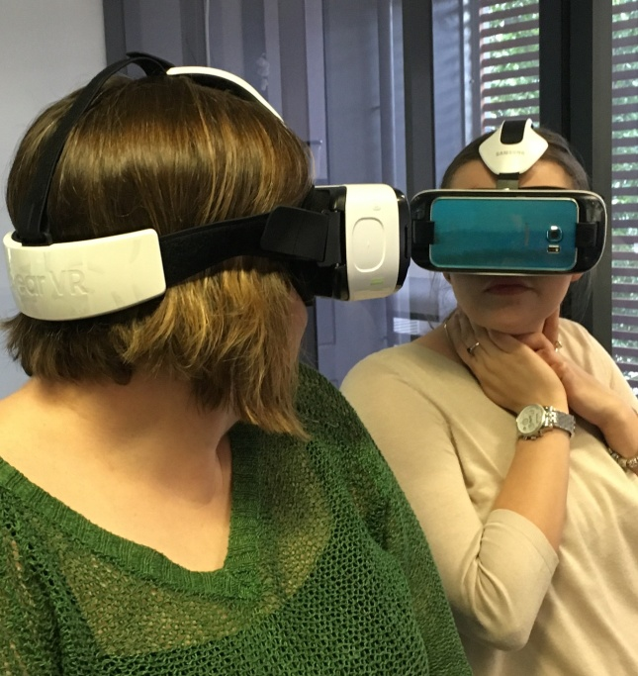
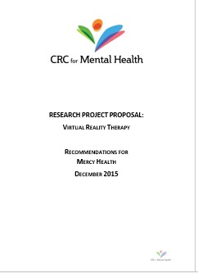
Mercy Health
Promoting mental health and wellbeing within residential aged care facilities
In 6 weeks, we:
Undertook a literature review of the use of virtual reality as reminiscence therapy in the aged care setting
Developed a proposal for a pilot study
Provided practical recommendations to consider before commencing a project
  informed consent
  selecting end-points
  defining target populations
Notes:
The following year, I became involved in a second project with Mercy Health. Mercy Health is a catholic organisation providing residential aged care facilities across Australia aimed at promoting health and wellbeing.
Specifically, Mercy Health in Parkville (Mercy Place) were interested in using Samsung’s virtual reality (VR) platform as reminiscence therapy to enrich and improve residents’ behaviour and mood.
Collaboratively working alongside two other students, we developed a proposal for a pilot study to test the usefulness of the VR technology in aged care, and given the study constraints associated with conducting a study in the aged care setting, provided practical recommendations for the study organisers to consider, prior to commencement of the project.

Slide 34
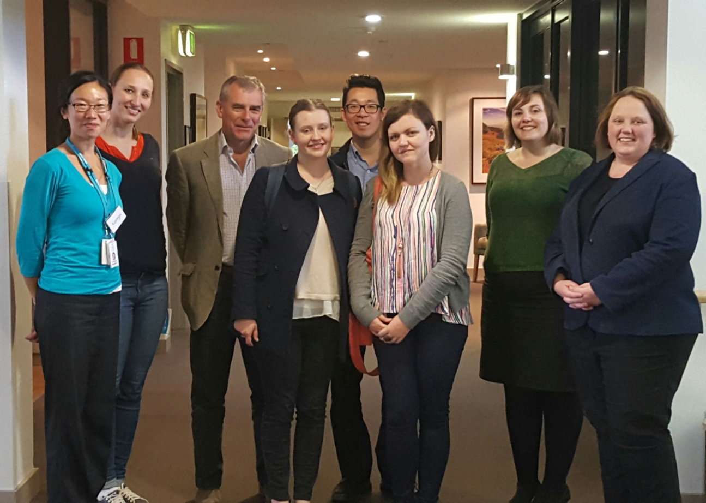
Mercy Health
Notes:
The great part about this project was that having had the previous consultancy experience, I could help lead the project and guide other students. It was a great opportunity to show initiative and work on a project that was quite different from the first.

Slide 35
What I can now demonstrate to employers
Project management and leadership
  Led a small team
  Delivered projects to stringent deadlines
  Ability to work in a diverse team
Business understanding
  Used data analysis to inform strategic advice to the client
  Adapted my scientific skills to research problem, identify potential solutions and prioritise these according to the client’s priorities and resources
  Ability to influence change in the client practices
Communication skills
  Communicated advice which impacted business decisions
  Experience presenting to senior management of clients
  Preparation of formal reports to client
Notes:
Both projects have allowed me to expand my skills beyond academia, develop my project management and leadership skills through practical experience, build a business understanding and improve communication between science and industry. The benefits of being part of this program outweigh the work associated with the projects.

Slide 36
How to implement the consulting projects
Recruitment of students and client with suitable project | Attendance at client meeting |  |  | Progress meeting with students | Review of presentation prior to client meeting | Attendance at client meeting |  |  | Contact with client to seek immediate feedback (Month 1) and ongoing impact (Month 3). Communication of these to students.
 | Client meeting and election of student to act as project manager | Production of client brief | Project work | Project work | Project work | Presentation to client | Project work to revise after client feedback (optional) | Finalisation of project (if did not occur at week 6)
 | Briefing given to student team | Review of student-prepared brief |  |  |  | Acceptance of report and presentation from students – opportunity to request amendments (optional) |  | Acceptance of final report (if did not occur at week 6) | Written immediate feedback to students (Month 1) and verbal feedback on ongoing impact (Month 3)
Pre-project Week 1 Week 2 Week 3 Week 4 Week 5 Week 6 Week 7 Week 8 Post-project
CRCMH
Students
Clients
Notes:
So from an organisational perspective, how much work goes into making these consulting projects happen?
Firstly, the consulting project wouldn’t work without the input of the CRC for MH, specifically the education coordinator.
This is a general work flow of how the consulting projects work, from the CRC, student and client perspectives.
So its best to explain this using an example, and we can use Volunteering Victoria as an example as this was the client for which CRC students worked with this year.

Slide 37

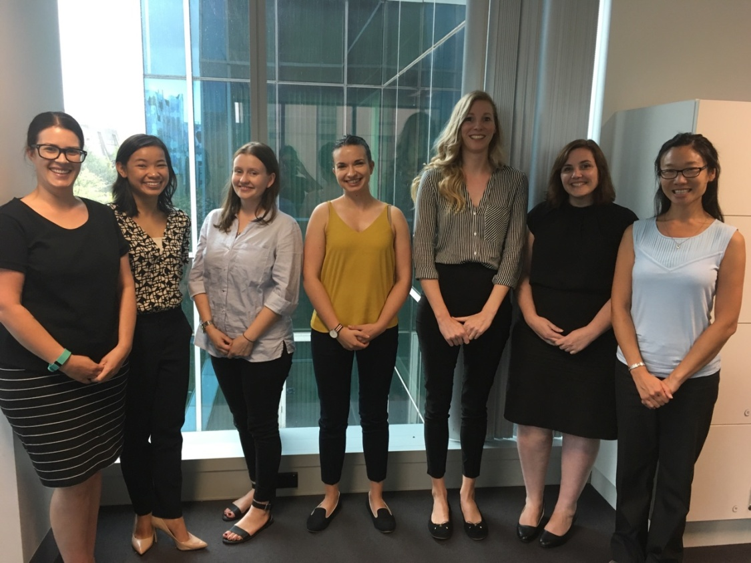
Volunteering Victoria
Providing resources to over 300 member organisations
Notes:
For this year’s consulting projects, the client was Volunteering Victoria. Volunteering Victoria provides resources to over 300 member organisations.

Slide 38
Volunteering Victoria
Recruitment of students and client with suitable project during the annual CRC workshop | Attendance at meeting with Volunteering Victoria |  |  |  | Progress meeting with students | Review of presentation prior to Volunteering Victoria meeting | Attendance at Volunteering Victoria meeting |  | Contact with Volunteering Victoria to seek immediate feedback (Month 1) and ongoing impact (Month 3). Communication of these to students.
 | Election of students to act as project managers and meeting with Volunteering Victoria | Production of Volunteering Victoria brief by project teams. | Project Group 1- Grants Team: Conducted a full review of all unsuccessful grant applications Developed a grant proposal strategy list (which and whether to apply for grants) Started a grant database for upcoming funding opportunities Put together a generic and scalable grant submission Project Group 2- Volunteers Team: Review of current research that focuses on the psychology of volunteers and their motivations Review existing strategies for retention of volunteers Identifying methods to target volunteer groups to recruit, retain and motivate Identified practical strategies and best practice recommendations when designing an effective volunteer program |  |  |  | Presentation to Volunteering Victoria | Project Group 1- Grants Team: Finalisation of project (if did not occur at week 6) Project Group 2- Volunteers Team: Project work to revise after receiving feedback from Volunteering Victoria (optional)
 | Briefing given to student team | Review of student-prepared brief |  |  |  |  | Acceptance of report and presentation from students – opportunity to request amendments (optional) | Acceptance of final report (if did not occur at week 6) | Written immediate feedback to students (Month 1) and verbal feedback on ongoing impact (Month 3)
Pre-project Week 1 Week 2 Week 3 Week 4 Week 5 Week 6 Week 7 Post-project
CRCMH
Students
Volunteering Victoria
Notes:
Once the suitable client was established, whether that be a small business or not-for-profit organisation, students were recruited to execute the projects. In this instance, there were two teams put forward to work on two separate projects, one on the evaluation of grant applications and the other on strategies for the recruitment, retention and motivation of volunteers. After the initial CRC facilitated meeting with the client, the groups took to producing a brief and then over the next few weeks worked on their projects. Once the project got going the CRC’s involvement was minimal. After a few weeks, the students presented their output to the client and any revisions and documents were finalised the following week.

Slide 39
How is it different to other industry projects
relevant work to your CRC
shorter time frame
don’t embed in the organisation
“consultant” to a small organisation
submission of deliverables/conferral
experience
Notes:
So something really great about running the program from within the CRC, is that you can select the clients based on the type of research your CRC is involved in. It’s been of great importance to our CRC that each of the clients that we’ve interacted with, play a role in contributing to improving mental health in one way or another.
Other than that, the CRC consulting projects have been different to other industry projects because they’ve only been run within a shorter time frame.
Also, the practical experience of consulting to a small organisation means that we don’t embed ourselves in the organisation.

Slide 40
Notes:
I think these experiences have been absolutely invaluable and the benefits of becoming involved in these projects definitely outweigh the work involved.
The projects have allowed me to expand my skills beyond academia, develop project management skills, build a business understanding and improve communication between science and industry, and most importantly be able to communicate these skills to potential employers.
Lastly in all seriousness, this experience has empowered me to pursue a career beyond academia

Slide 41
Notes:
and if all else fails… there’s always a secret plan to fall back on.

Slide 43
Activity
What’s an area you want to learn more about or improve this year?

Slide 44
Communities of practice:
What do you want to get better at this year?

Slide 46
Communities of practice
What do you already know that can help the group?
What are your individual networks that can help the group learn or practice?
How will you work together to improve your skills over the next year?
How will you share your knowledge with the wider group?

Slide 47
Community of practice – communications
Meet monthly to practice verbal and written communication skills
Individual members have sought out media training, developed awards applications, written general articles about their PhD experience – importantly, they then tell their peers what they learnt

Slide 48
Community of practice – time management
Monthly emails
“My first task will be [achievable goal] which I want to finish by [timeframe]. If I achieve this, I want to [reward]
Importantly accountability to group
“No reward for me this month. I am now determined to get this done for next month – I’ve allocated specific time so I can complete it”

Slide 49
Community of practice – career focus
Group emails which circulate articles of interest
Articles with broader appeal also posted to CRCMH LinkedIn group
Individual members have discussed their own career goals and report back on how they’re pursuing these

Slide 50
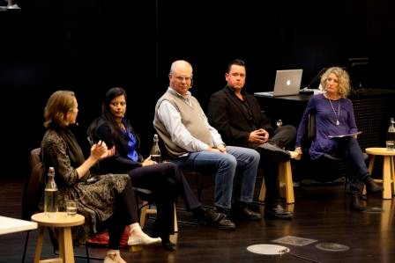
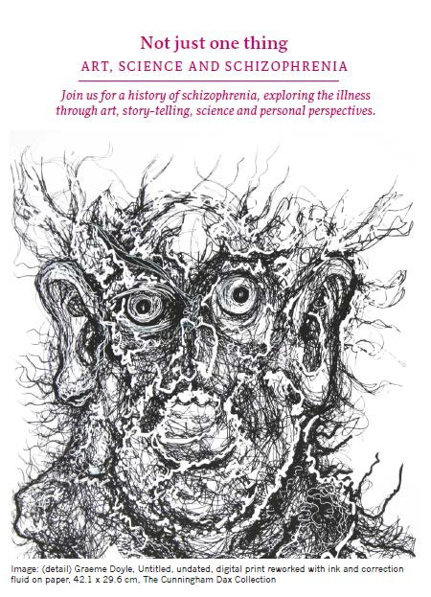
Community education
Topic chosen after consultation with researchers and endusers
Panel: Researcher, clinician/enduser, person with experience of mental illness Host: Journalist

Slide 51
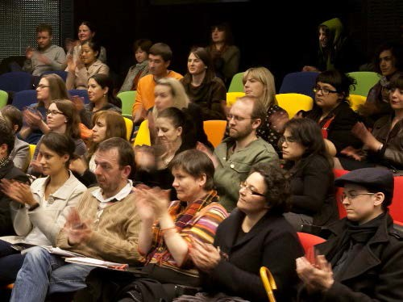

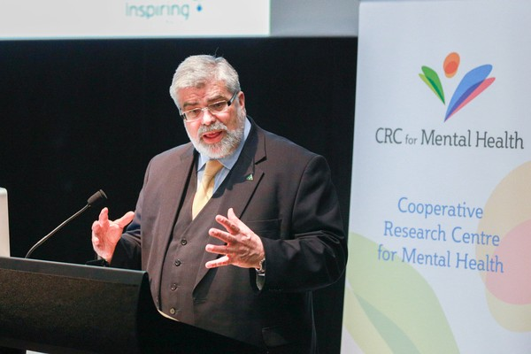

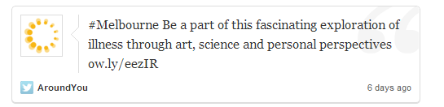
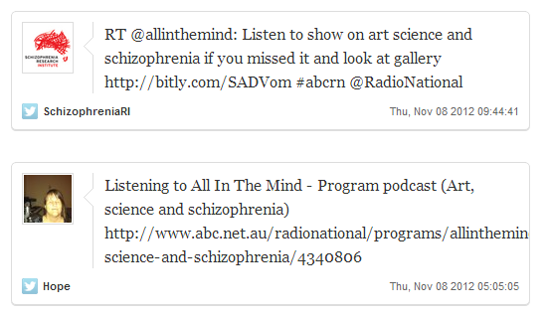


New audience for Participants
Fringe festival exposure to 250,000 people, ~60% had not attended science event in past year
New funding source: Inspiring Australia
Strong focus on endusers
Clinical, mental illness advocacy and community endusers
Media & social media attention: Broadcast reached ~36,000 people
Government relations: Interest from Minister

Slide 52
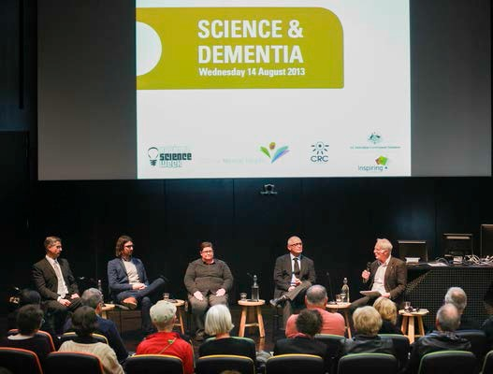
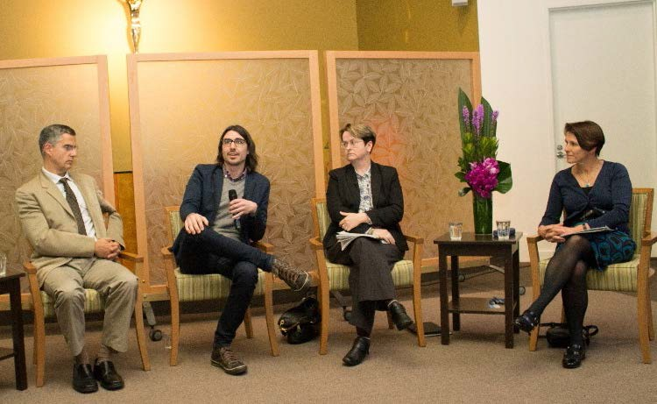
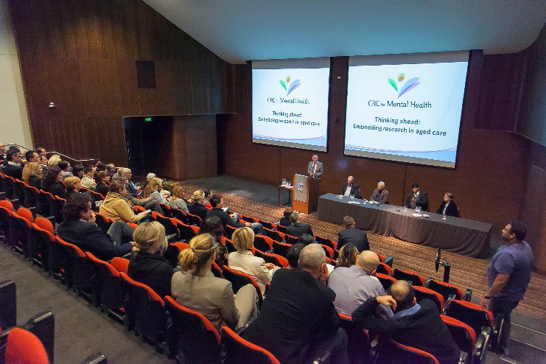
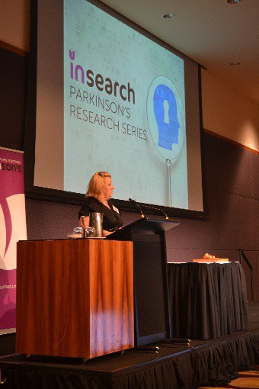
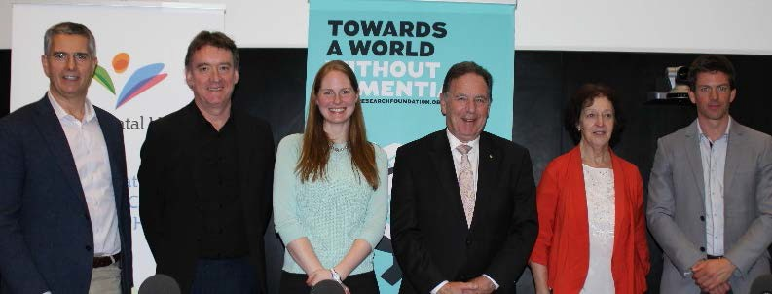
Schizophrenia (2012)
Alzheimer’s disease (2013)
Depression and dementia (2013)
Embedding research in aged care (2014)
Parkinson’s disease (2015)
Diagnosing dementia (2015)

Slide 53
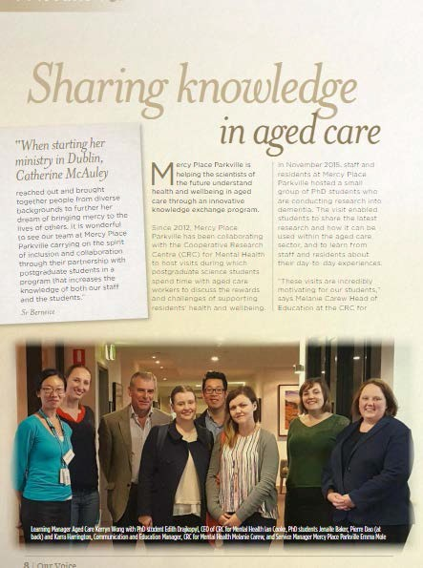
Developing empathy

Slide 54
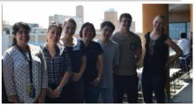
Outcomes
66% of students reported taking an action as a result of the visit
  Uptake of volunteer work, discussing the visit with their peers, reading more about aged care or how research is taken up into clinical practice

Slide 55
Outcomes of visits
“It really opened my eyes into the gap between research and reality”
“This has given a different perspective on the illness I am studying, that is, a perspective from a personal level rather than on the neurochemistry”
“I am currently moving fields and would consider a career in aged care where I wouldn’t have previously”

Slide 56
CRCMH touch points with students
JAN | FEB | MAR | APR | MAY | JUN | JUL | AUG | SEPT | OCT | NOV | DEC
CRCMH
Research conference
CRCMH
student workshop & visit to aged care facility
Consulting projects (optional)
Collaborative writing, professional development workshops, one to one mentoring, communities of practice

Slide 57
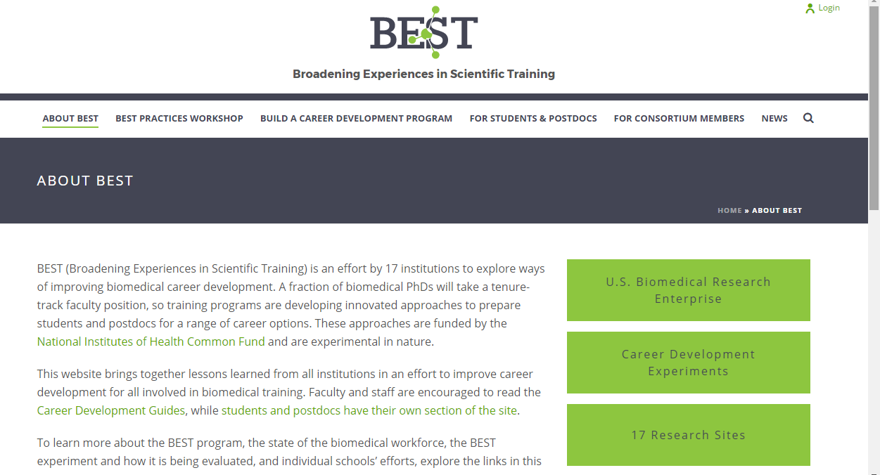
International model

Slide 58
Evaluation

Slide 59
~ 85% of CRCMH students indicated that involvement in the CRC has given them skills and capabilities that they would not have gained otherwise
 | Not at all | To a small extent | To a moderate extent | To a large extent
Expansion of skills beyond the purely academic | 0% | 8% | 23% | 69%
Insight into the commercial world | 0% | 23% | 31% | 46%
Establishing a network of contacts | 0% | 0% | 15% | 85%
Opportunity to work on finding solutions to 'real world' problems | 0% | 23% | 15% | 62%

Slide 60
CRCMH students felt more strongly that their research higher degree experience had given them the skills necessary to succeed in a wide range of careers
CRC students avg: 3.82 Non-CRC students avg: 3.1

Slide 61
Will involvement with CRC provide career advantage?

Slide 63
Program | Plan
Community education | Model published in Australasian Psychiatry, presented at RANZCP , working with our Participant research organisations regarding uptake
Knowledge exchange program | Submitted for publication in aged care profession journal
Videoconferences | Available for uptake by other CRCs, universities, student groups
Cohort building approaches | Available for uptake by other CRCs
Collaborative writing program | Preparing to publish, available for uptake by other CRCs, universities, student groups
Publico program – consulting | Available for uptake by other CRCs, universities, not-for-profit sector
Communities of practice | Available for uptake by other CRCs, universities, student groups
Evaluation model | Available for uptake by other CRCs – possibility to combine data

Slide 64
CRC for Mental Health education legacy
Graduates who remain connected, confident and aware of how collaboration benefits them
Graduates with demonstrated experience and success working cooperatively with researchers and non-researchers
Graduates who are comfortable working in, or with, a broad range of industry

